Slide 1

Natural Language Processing
In Python with Projects

Slide 2
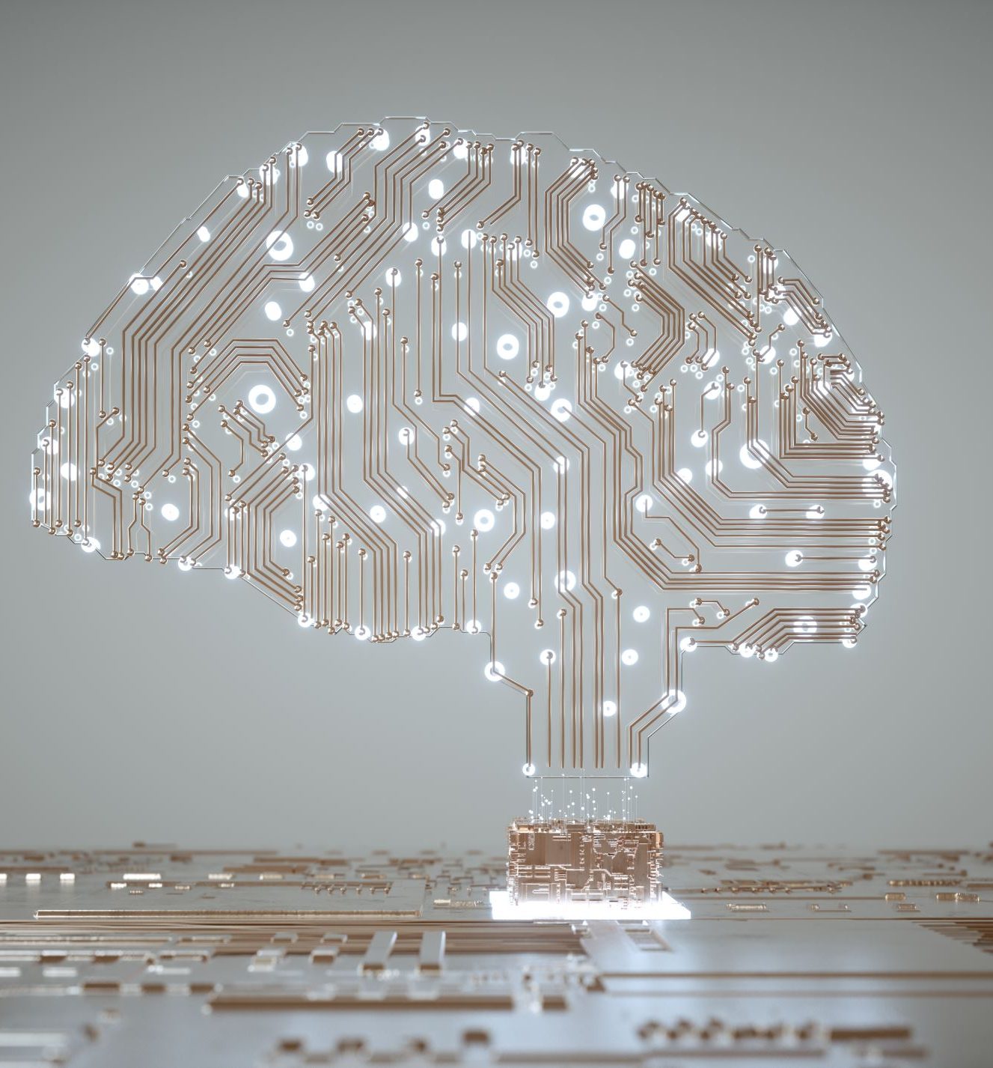
What is NLP?
Natural language processing (NLP) is a subfield of computer science and artificial intelligence (AI) that uses machine learning to enable computers to understand and communicate with human language.

Slide 3

What is NLP?
NLP enables computers and digital devices to recognize, understand and generate text and speech by combining computational linguistics—the rule-based modeling of human language—together with statistical modeling, machine learning and deep learning.

Slide 4
Benefits of NLP
NLP makes it easier for humans to communicate and collaborate with machines, by allowing them to do so in the natural human language they use every day. This offers benefits across many industries and applications.

Slide 5
Benefits of NLP
Automation of repetitive tasks
Improved data analysis and insights
Enhanced search
Content generation

Slide 6

Automation of Repetitive tasks
NLP is especially useful in fully or partially automating tasks like customer support, data entry and document handling.

Slide 7

Improved data analysis
NLP enhances data analysis by enabling the extraction of insights from unstructured text data, such as customer reviews, social media posts and news articles. By using text mining techniques, NLP can identify patterns, trends and sentiments that are not immediately obvious in large datasets.

Slide 8

Enhanced search
NLP benefits search by enabling systems to understand the intent behind user queries, providing more accurate and contextually relevant results. Instead of relying solely on keyword matching, NLP-powered search engines analyze the meaning of words and phrases, making it easier to find information even when queries are vague or complex.

Slide 9

Powerful content generation
NLP powers advanced language models to create human-like text for various purposes. Pre-trained models, such as GPT-4, can generate articles, reports, marketing copy, product descriptions and even creative writing based on prompts provided by users. NLP-powered tools can also assist in automating tasks like drafting emails, writing social media posts or legal documentation.

